Slide 1

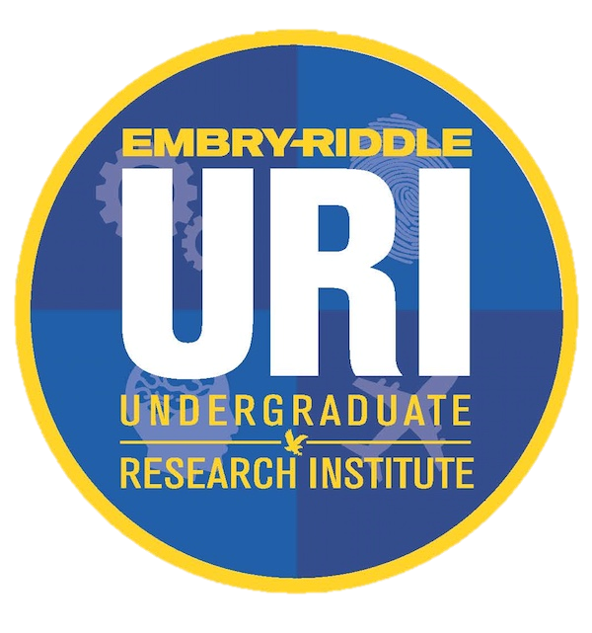



Partner
Characterization of Defects in Crystalline Optical Coatings
Breck Meagher₁, Mentor: Dr. E. Gretarsson₂, Dr. A. Markosyan₃, Dr. A. Gretarsson₄
Department of Physics and Astronomy₁,₄, Department of Aerospace Engineering₂, Stanford LIGO Group₃
2023 Arizona NASA Space Grant Statewide Symposium

Slide 2

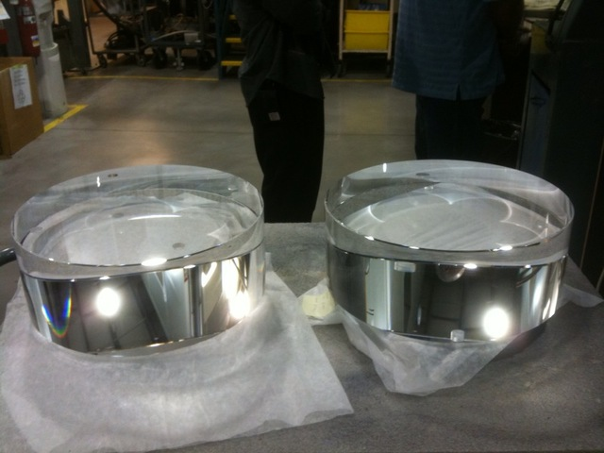
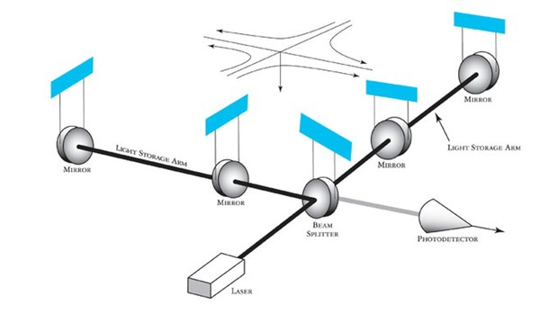
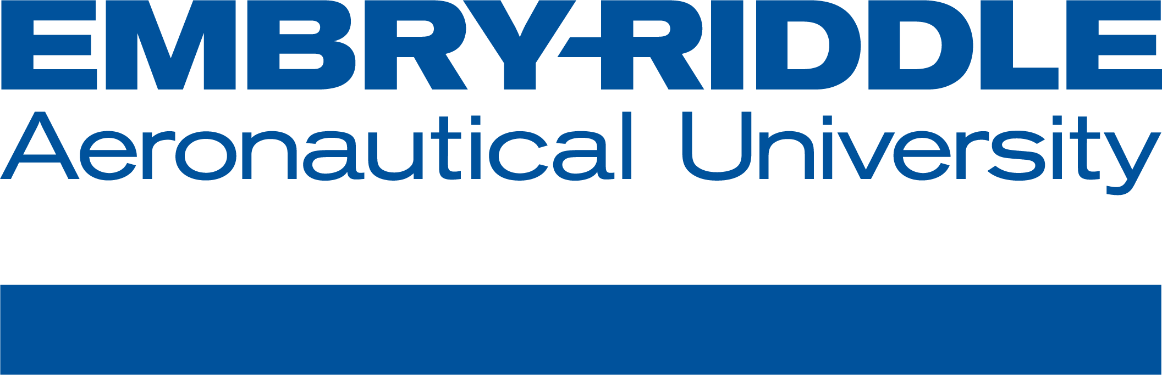
LIGO
[2]
Amorphous, dielectric coatings
  Highly reflective
  Minimal optical loss
[1]
Figure 1. Basic Interferometer Diagram, LIGO Caltech
2
Figure 2. Two LIGO ‘Test Masses’, LIGO Optics Caltech

Slide 3
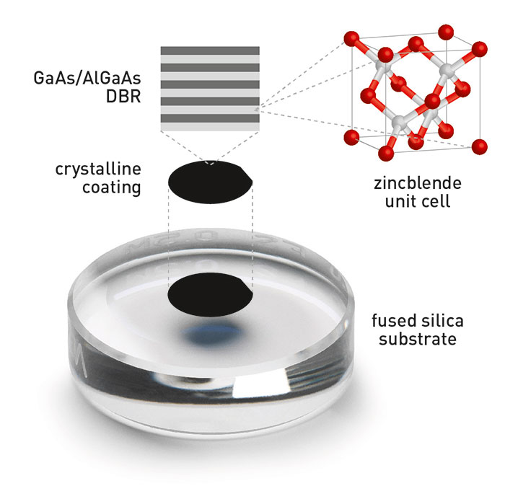
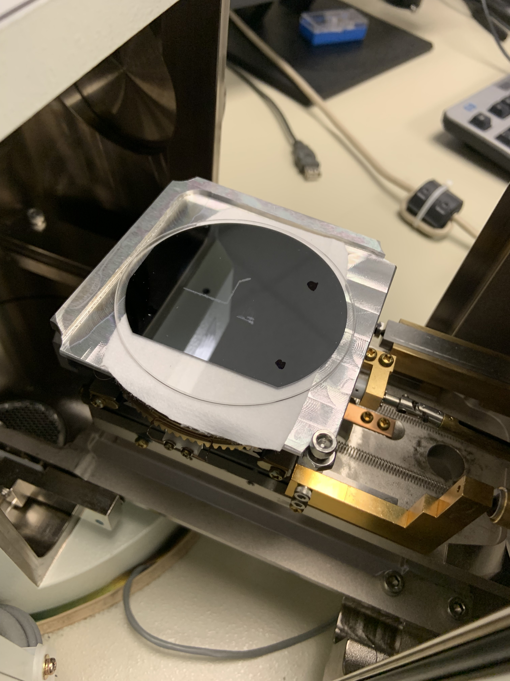
AlGaAs Coatings
Monocrystalline Aluminum Gallium Arsenide
10x reduction in thermal noise
Defects despite high purity
[3]
3
Figure 3. Adapted from “Typical Semiconductor Supermirror”, Garret Cole, et. al.

Slide 4
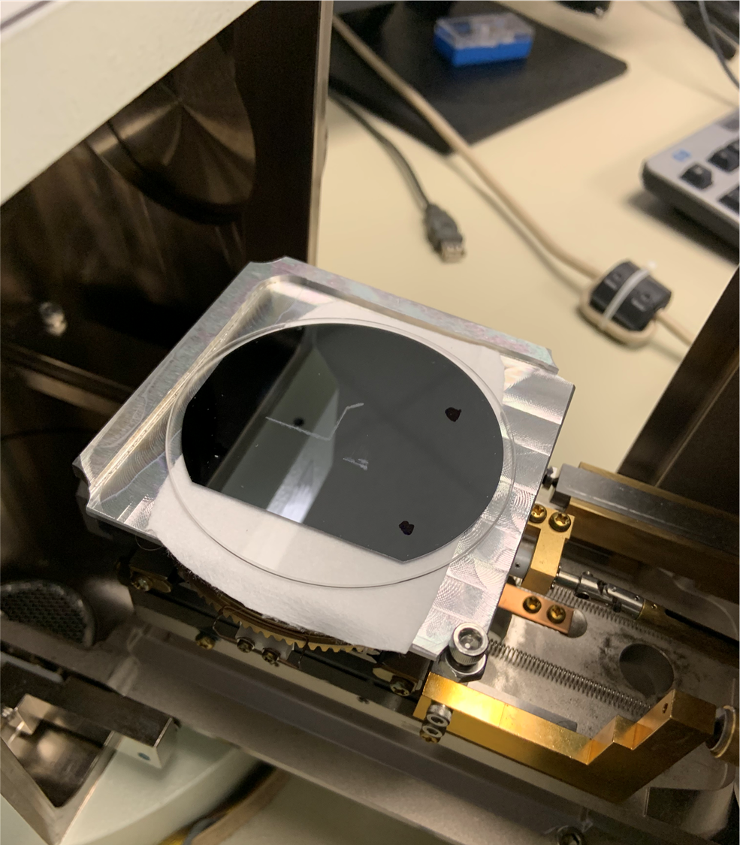
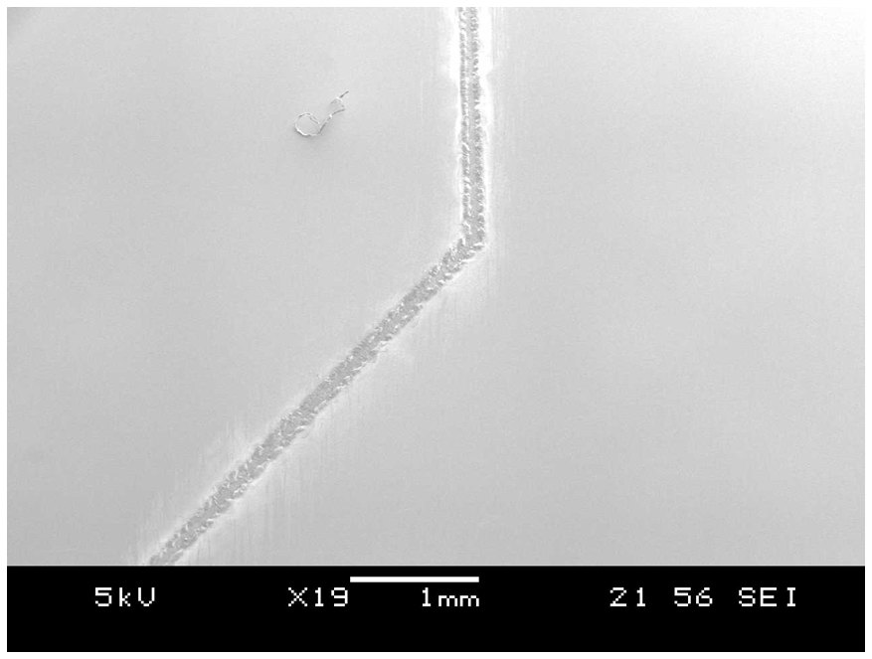
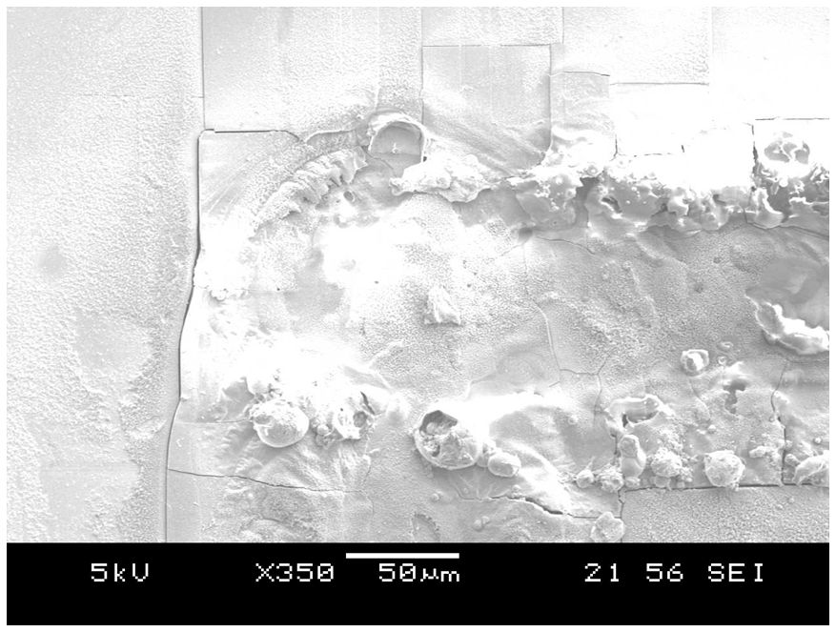
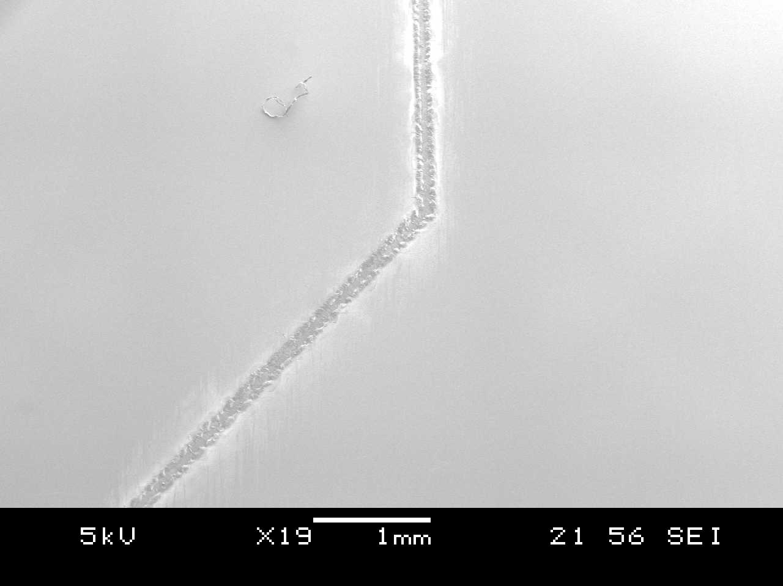
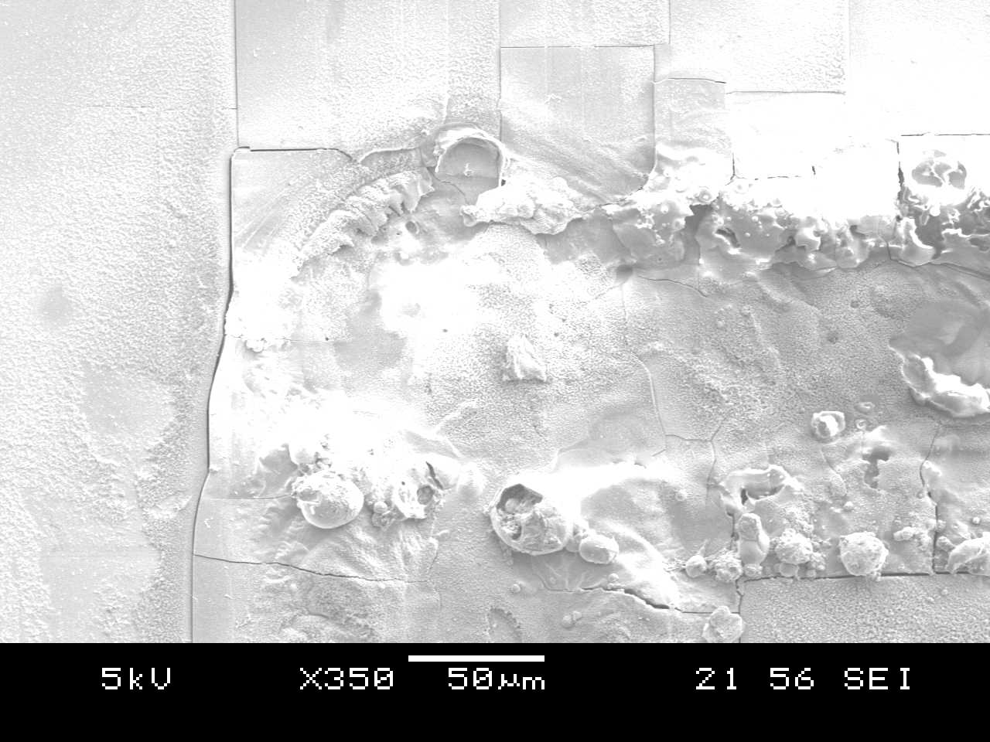
Imaging the Defects
Coating Damage
4
Sample Damage

Slide 5
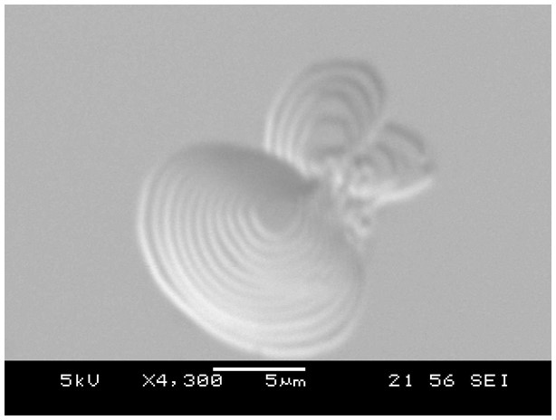
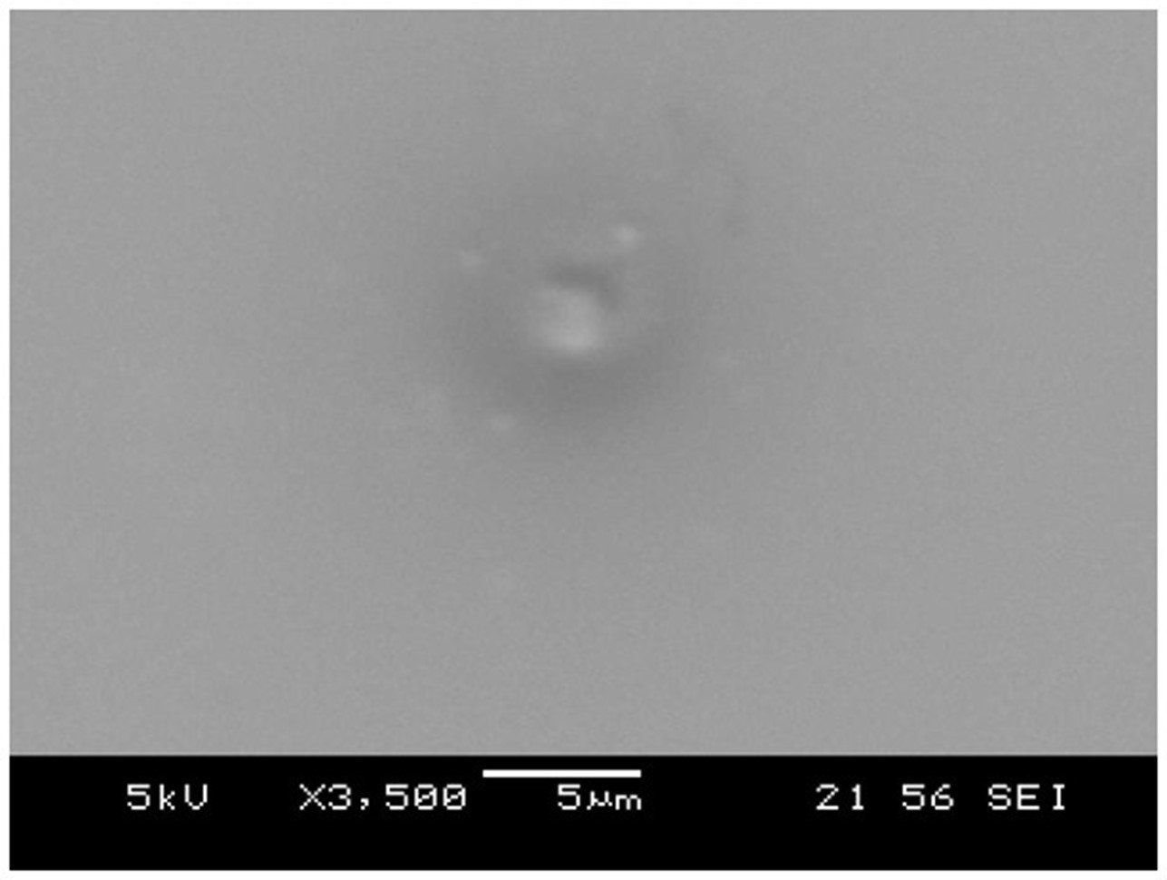
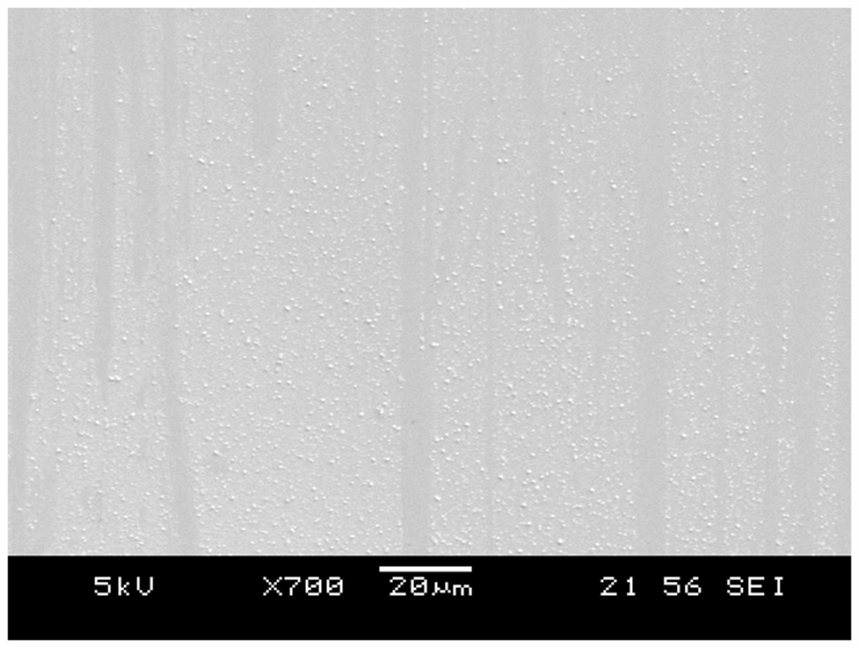
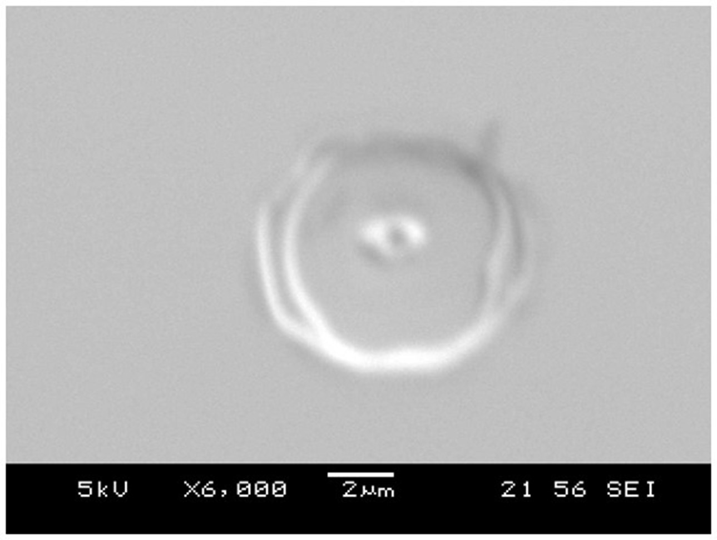
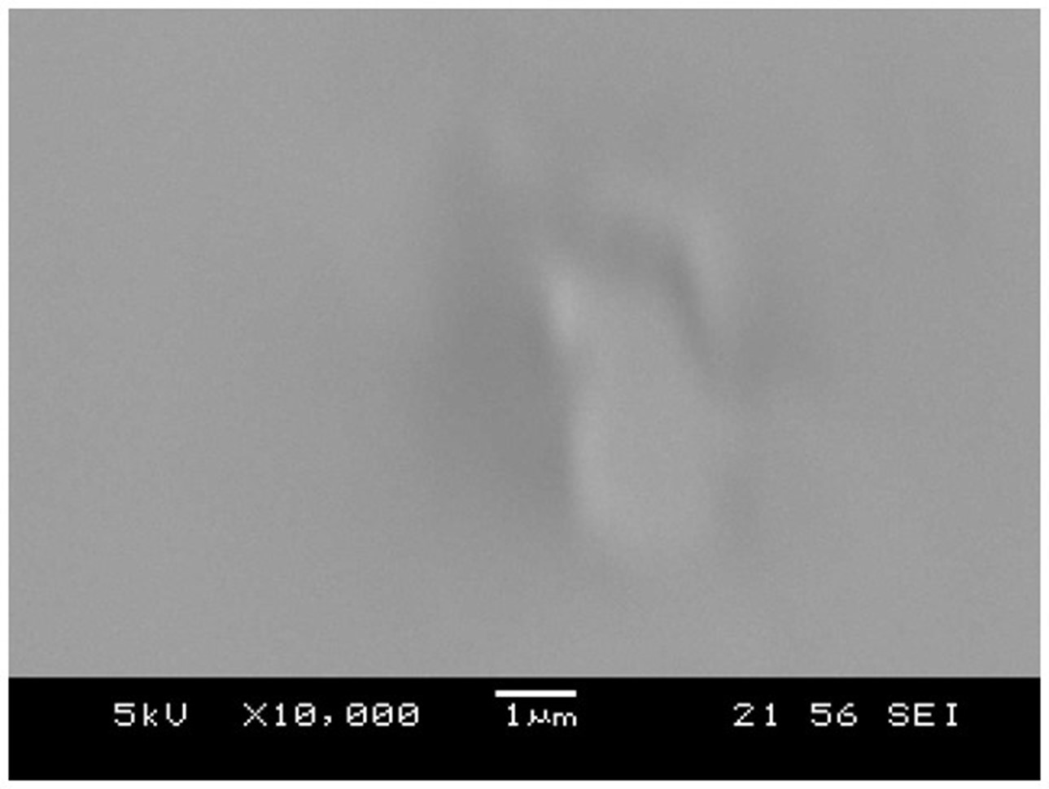
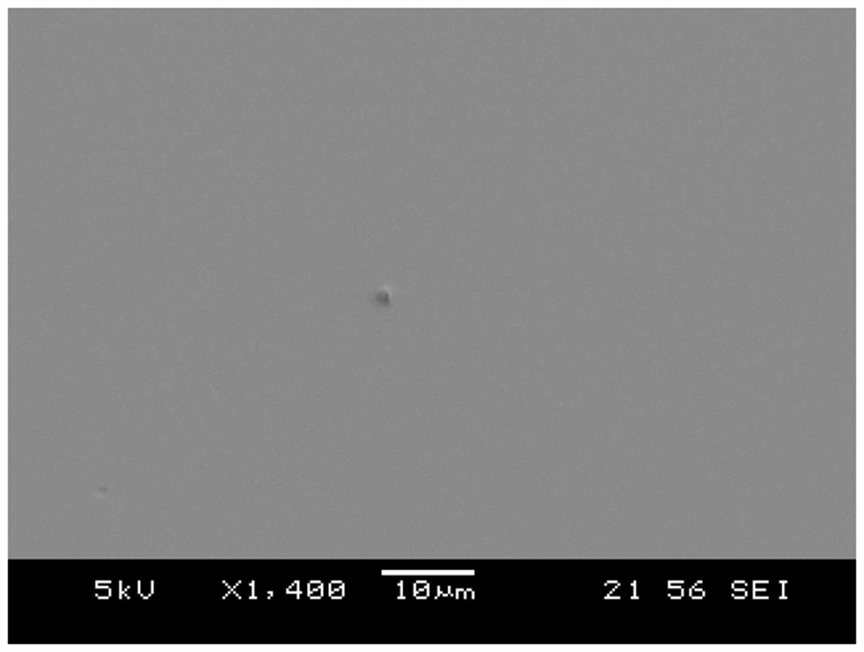
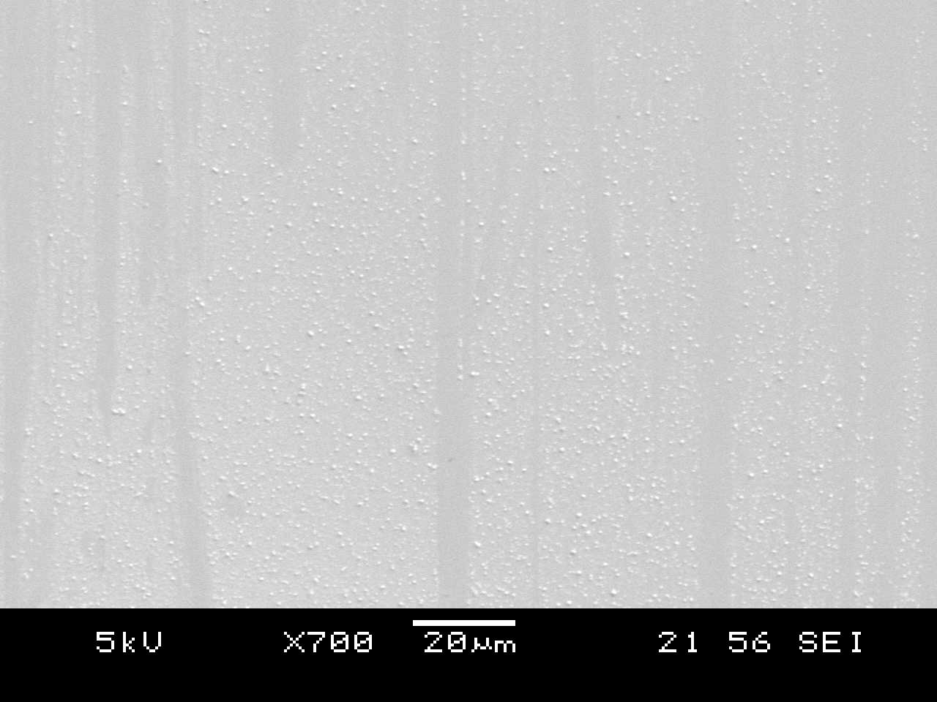
Types of Defects
Shells (~5 μm)
Indents into surface
Pyramids (~1 μm)
Raised above surface
Damage (<1 μm)
Debris on surface
6

Slide 6
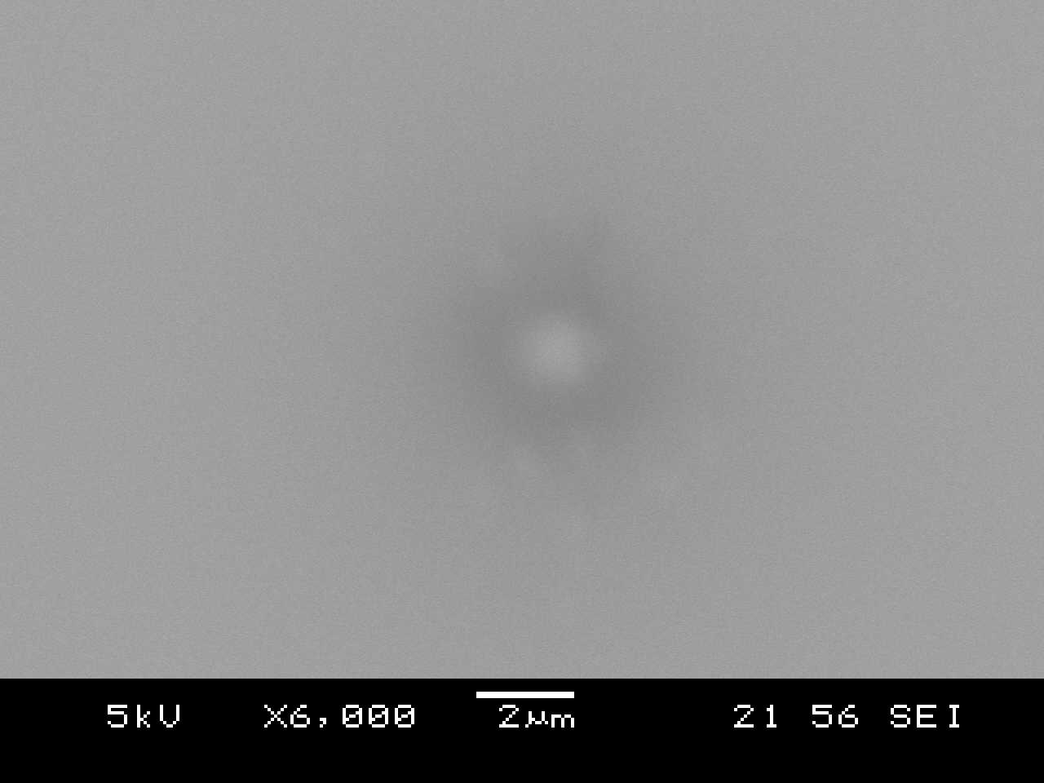
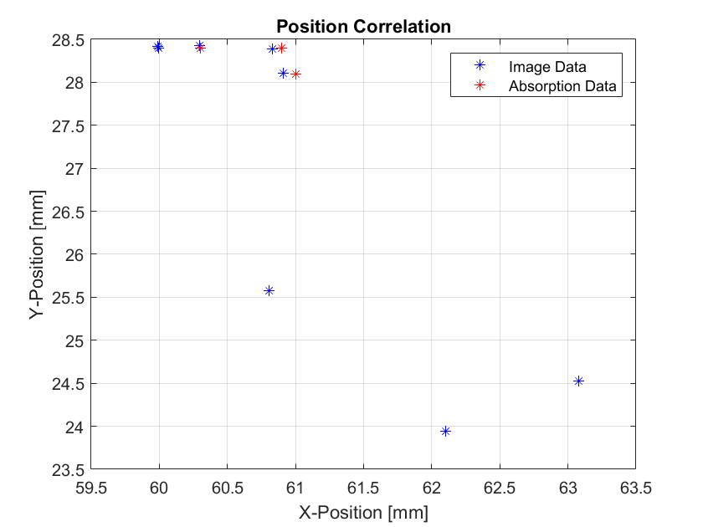
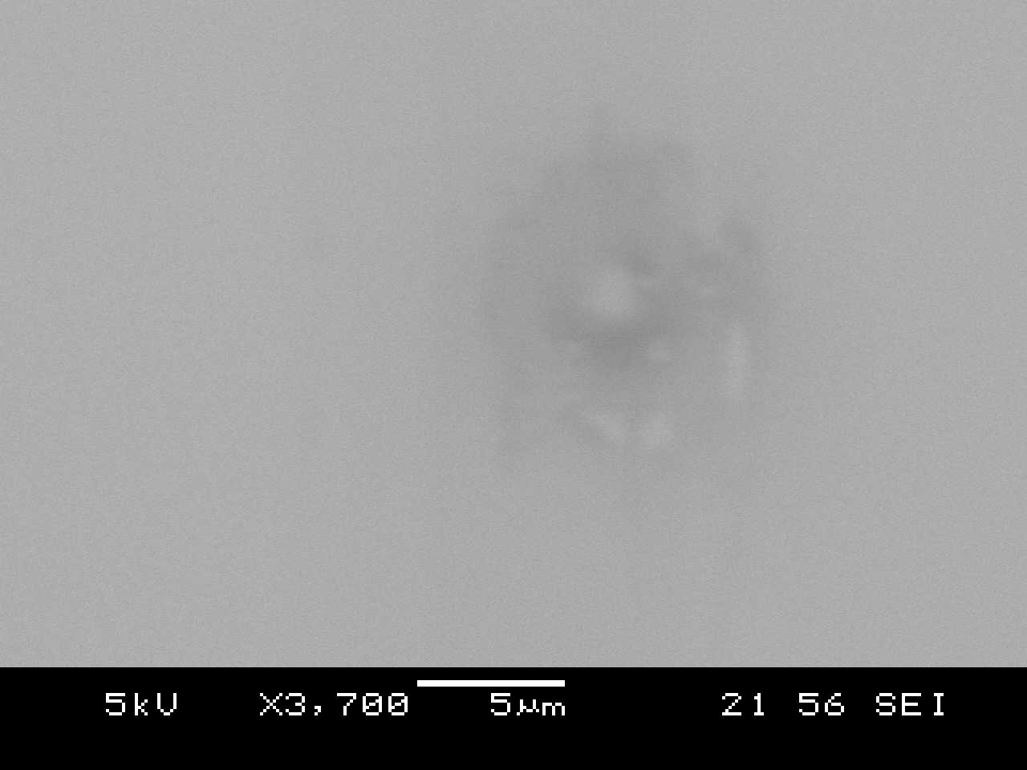
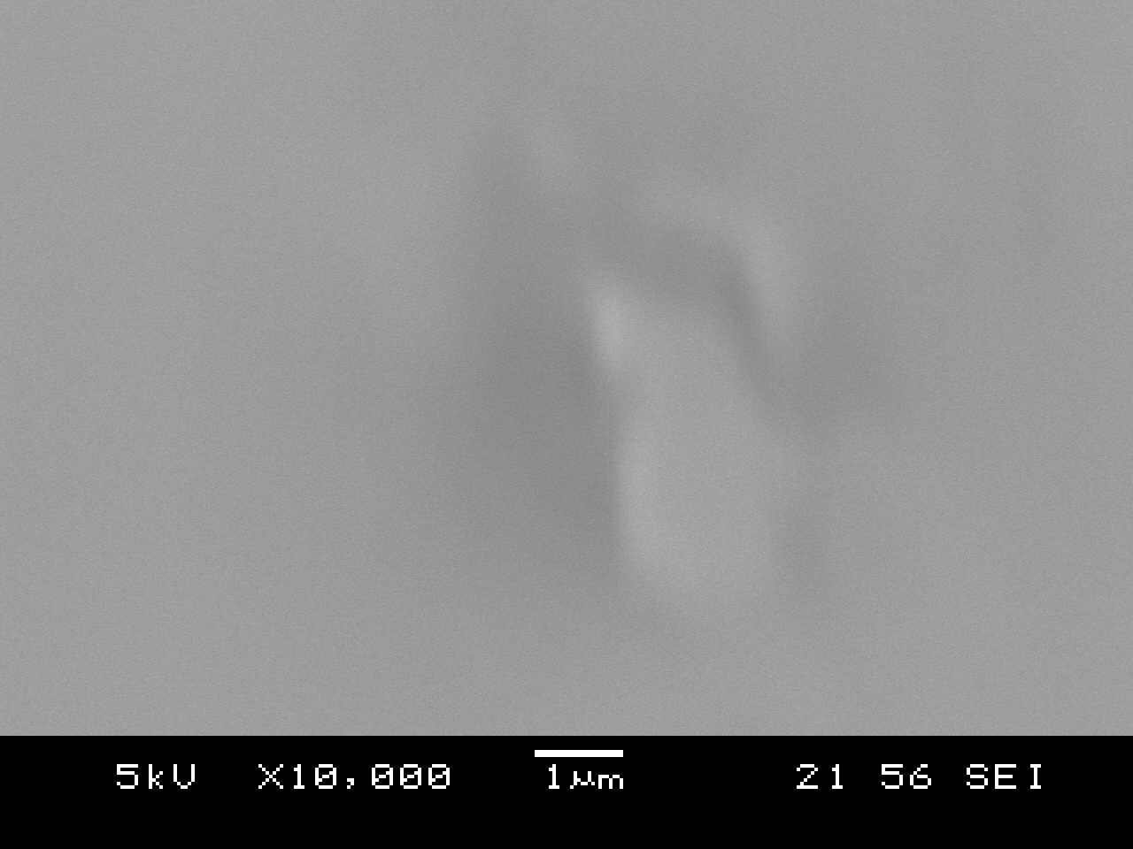
Absorption
14,710 cts
10,320 cts
23,810 cts
SEM data plotted with overlapping absorption data
8

Slide 7
Conclusions & Future Plans
Conclusions
  Absorption data can be correlated to SEM measurements
  Surface defects are characterizable
Future Plans
  Obtain size and distribution characteristics over a large area
  Analyze additional samples
9

